Slide 1
Daily Five and Cafe
in a
Middle Years Classroom

Slide 2
Daily Five and The Café by Gail Boushey and Jean Moser

Slide 3
What is Daily Five
http://www.youtube.com/watch?v=5Okeh1If7sM&feature=player_embedded
Daily Five In Middle Years

Slide 4
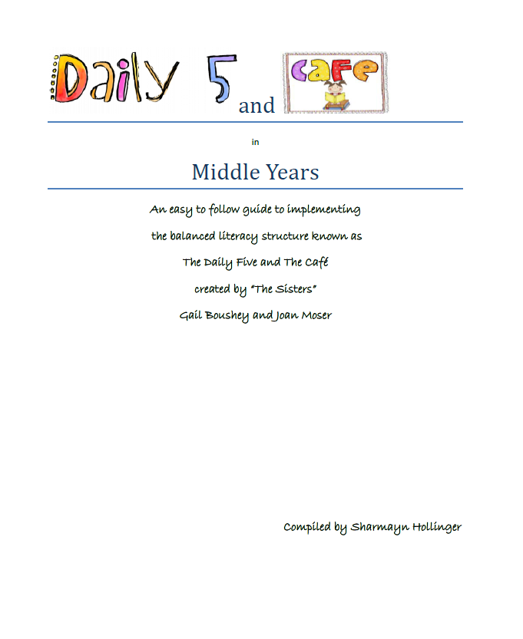
Planning

Slide 5
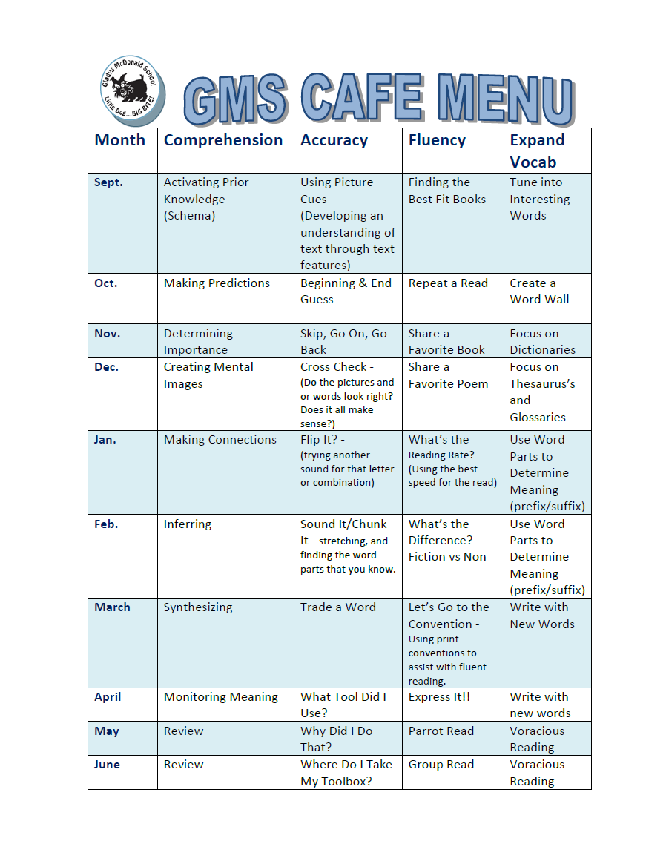
Yearly Planning

Slide 6
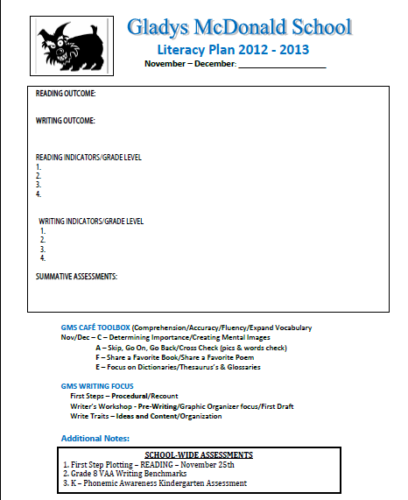
Monthly Planning

Slide 7
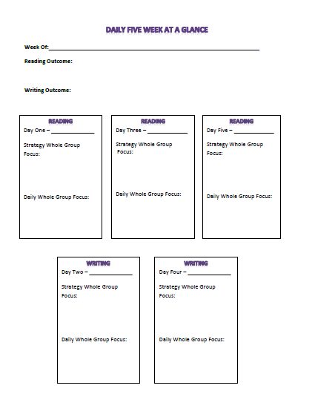
Weekly Planning

Slide 8
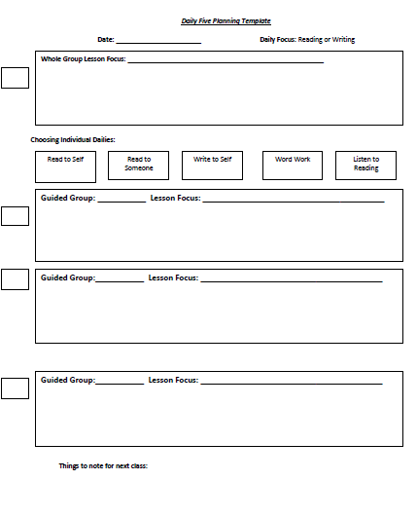
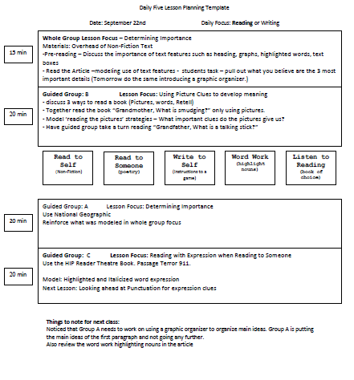
Daily Planning

Slide 9
Keeping Track
Teaching Pensieve
- sorted by guided groups
- sorted by grade
- alphabetical
Student
log books
book boxes
pictures with clothes pins
daily tracking sheet (glued in log book)
guided reading duo tang
word work folder
writing folder

Slide 10
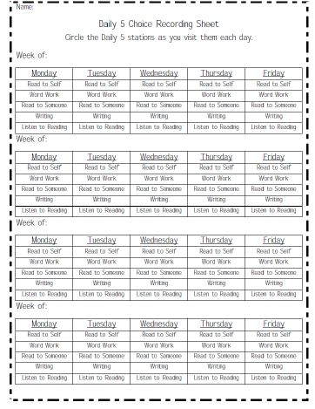

Slide 11
If you would like more information, Come for a school visit. Our principal and staff would be happy to see you!
Contact Lori Daelick at 791-8500

Slide 12
Questions, comments, Clarification
Thank you For COming

