Slide 1
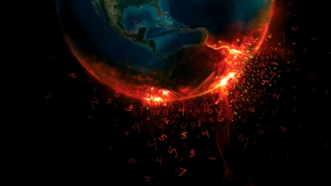
//Global Warming//

Slide 2
My Topic : Global Warming
For this project I will be teaching about Global Warming using my best of knowledge, I will be answering the following questions.
What is Global Warming?
Is it a “Hoax” Like some people claim?
What are the effects of Global Warming?
What is Global Warming doing to the world?
Where is global warming happening the most?
Is Global Warming a danger?
What causes Global Warming?
How do we overcome it?
Fun Facts
The earth is covered
With 70% water and
Humans have only
Discovered 5% of it.

Slide 3
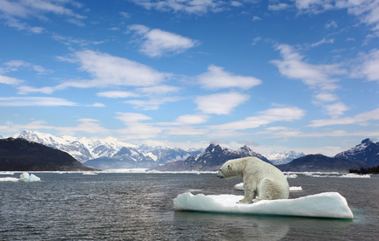
What Is Global Warming?
Global warming is the gradual warming of the earth. Scientists say that this has been happening since the 1800s and the temperature has risen by 0.8 degrees Celsius. This may seem like so little but this is still happening and scientists predict that 100 Years from it will have raised 11.5 degrees Celsius. Thats Crazy! Places that are already hot will be scorching hot! People don’t understand the damage that this does, you may or may not have heard about the Polar Ice Caps melting. There are other things happening too and people still think it's a “Hoax”. Smell the roses Bro and wake up, these are things happening right now and it is slowly affecting our lives.

Slide 4
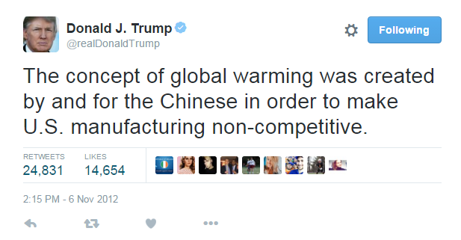
Is It A “Hoax” like some say? !!!LIER ALERT!!!
“It's a Hoax”, “It isn’t a Hoax”, Everybody has their own Opinion on what they think is true, and no one can really prove that it is the effects of Global Warming, but there are things that can support the topic to show that is could be Global Warming. My opinion is that Global Warming is for real. People like Donald Trump believe it's a Hoax, he says “The concept of Global Warming was created by and for the Chinese in order to make U.S. manufacturing non-competitive.”

Slide 5
What are the effects of Global Warming?
Over the years the earth has changed in many different due to Global Warming. Things have changed like………
Some butterflies, foxes and alpine plants have moved farther to the north or to higher cooler places.
A researcher named Bill Fraser has tracked the decline of Adelie Penguins on Antarctica, their numbers have fallen from 32,000 breeding pairs to 11,000 in 30 years!
Ice is melting worldwide especially at the earth's poles (North, South)

Slide 6
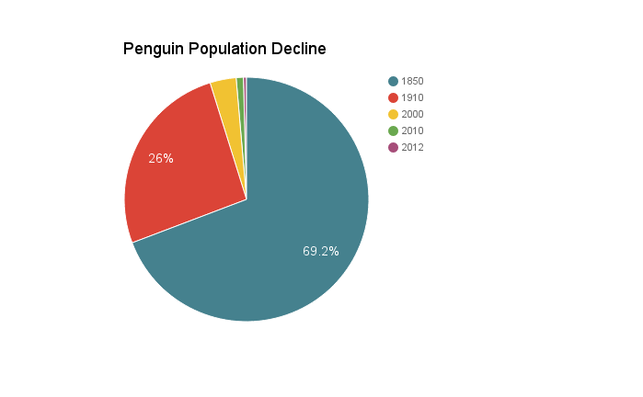
Amount Of Penguins
1850 - 4,000,000
1910 - 1,500,000
2000 - 200,000
2010 - 55,000
2012 - 23,700

Slide 7
The Waterlife Decline
Penguins, bears, fish, and ex. Are all affected by the same thing, Global warming. Animals like penguins and polar bears who live on ice caps are affected because as the temperature grows the ice caps they live on are slowly melting leaving them without a place to live, or create a family of their own. Sea life that live in water are affected because of how us humans treat the water, we put garbage, oil, gasoline and lots into water not thinking about how it will affect them and us. The water can become so gross that it can cause sea life to die. It not just the polar bears and penguins that won't have anything to eat, we won't either! And With global warming if the icecaps melt it causes floods or it causes all the water to evaporate and we won't have any water at all.

Slide 8
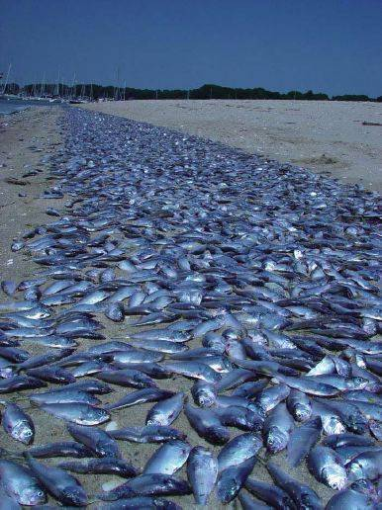
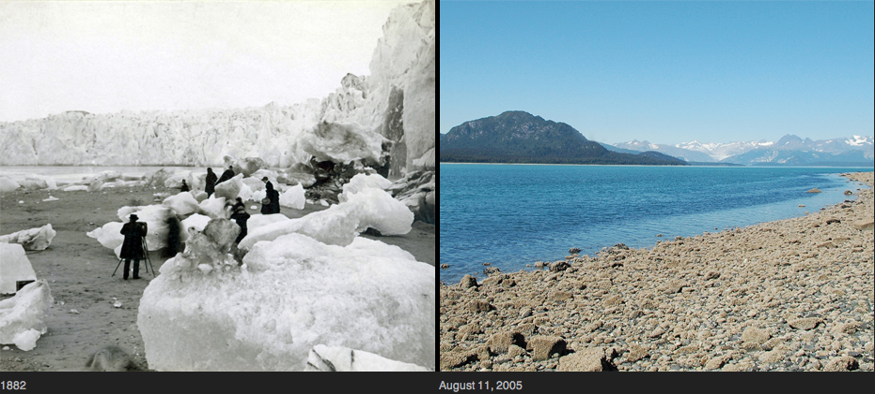
Some pictures of how global warming has affected sea life

Slide 9
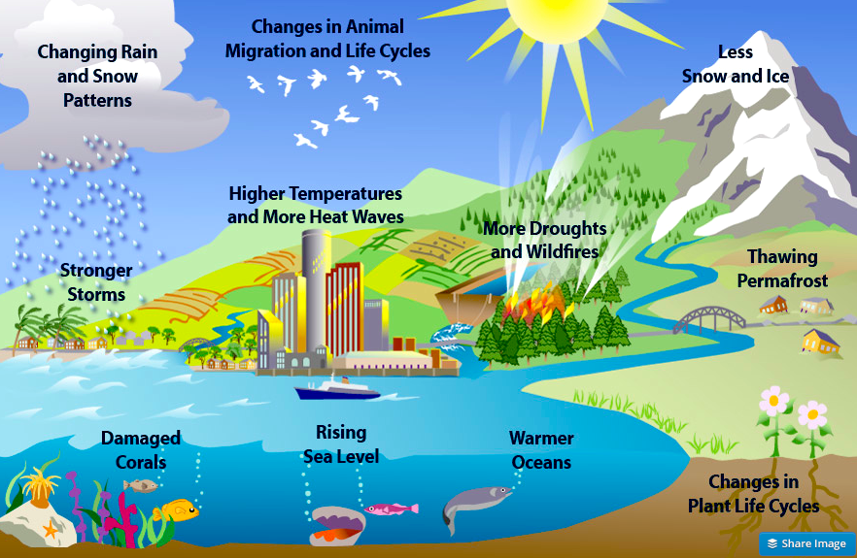
Where is global warming happening the most?
According to my research global warming is happening the most in places like Bangladesh, Sudan, Caribbean, Australia, Siberia, Tuvalu, Great Barrier Reef, Alps, and Britain. They are most affected with Floods, droughts and Crazy weather, a cause of global warming due to the earth's slow changes.
More effects of global warming

Slide 10
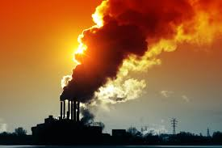
Is Global Warming A Danger?
Most definitely Yes! Whats going on is not healthy for us or the earth itself. As the earth's slowly changing, were also in for big change too. We are going to have to deal with extreme weather, food/items becoming more rare and more. It is also a danger for animals too whose habitats are going extinct and them themselfs are going extinct.

